Slide 1
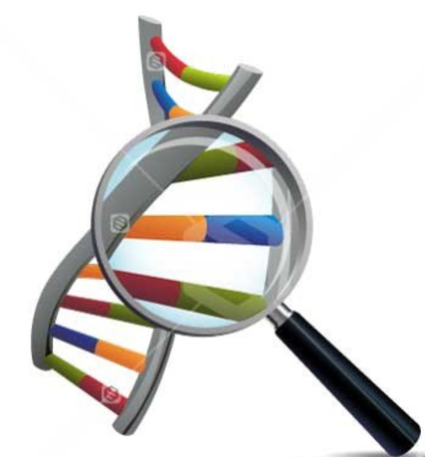

Evidence for Evolution
Comparative Studies in Biochemistry
DNA

Slide 2

Overview
Idea of evolution and evidence for it accepted by vast majority of scientists
Has been controversial for reasons unrelated to the scientific evidence
Important to look at evidence to support scientific theory
Recent advances in technology provide further evidence to support the theory of evolution

Slide 3
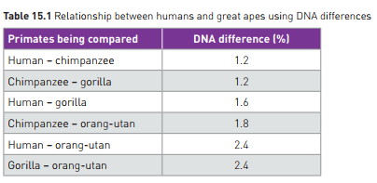
Comparative Studies in Biochemistry - DNA
DNA
uses sequences of 4 nitrogenous bases
Codes for protein production
All living things use the same 4 bases, the same DNA code
Sequence of bases varies
Mutation
Natural selection
Genetic Drift
As living things reproduce, code differs over generations between offspring, despite common ancestor, but some stays the same.
More distantly related: greater variation
Closely related: more shared

Slide 4
Comparative Studies in Biochemistry - DNA
Chromosomes also contain sequences of bases that don’t appear to code for anything:
“junk DNA”
Also vary across generations
Can also be compared for similarities and differences to assess relatedness.
Example: Endogenous retroviruses (ERV)
Viral sequence that has become part of the organism’s genome in the germline cells
Passed on to each new generation
Make up 8% of human genome
Other primates have some of the same sequences in the same locations, indicating that we, and they, are descended from a common ancestor who was originally infected with the virus.

Slide 5
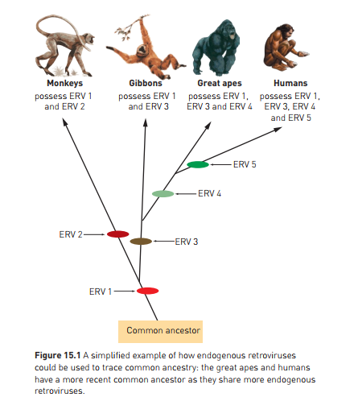

Slide 6
Comparative Studies in Biochemistry - DNA
PCR can be used to amplify tiny amounts of DNA
Facilitates sequencing
Allows small amounts of DNA from fossil record to be analysed
Electrophoresis
Also used to create profile and compare
Bacterial enzymes (restriction enzymes)
Used to cut up DNA to sequence it.
** Processes discussed in Ch 13 are a key part of sequencing DNA for analysis of relatedness between species

